Slide 1
Indian Weather repository
Code X IBM-ADIT 2022-2024

Slide 2
content
Problem Statement
Project Overview
Why we need this?
How it will help people?
Solution
How it’s Unique
Modelling(Analysis Model)And Visualisation
Live Demo – Analysis Dashboard
Result(Prediction Model)

Slide 3

Problem statement
Data Inconsistencies
Technological Outdatedness
Limited Regional Coverage
Historical Data Gaps
Disaster Response Challenges
Accessibility Hurdles

Slide 4
Project overview
The Indian Weather Repository project aims to establish a centralized and comprehensive platform for collecting, managing, and disseminating weather data across India. By addressing existing challenges in data accessibility, accuracy, and user-friendliness, the project seeks to empower various sectors in making informed decisions related to agriculture, disaster management, urban planning, and healthcare.

Slide 5

Why we need this?
Diverse Climate Zones
Agricultural Dependency
Vulnerability to Extreme Weather Events
Water Resource Management.
Urban Planning and Infrastructure Development
Disaster Management
Scientific Research and Innovation
Public Awareness and Education

Slide 6
How it will help people?
Timely Weather Information
Agricultural Planning.
Disaster Preparedness and Response
Water Resource Management
Public Health Protection
Energy Sector Optimization
Tourism and Recreation Planning
Environmental Monitoring

Slide 7
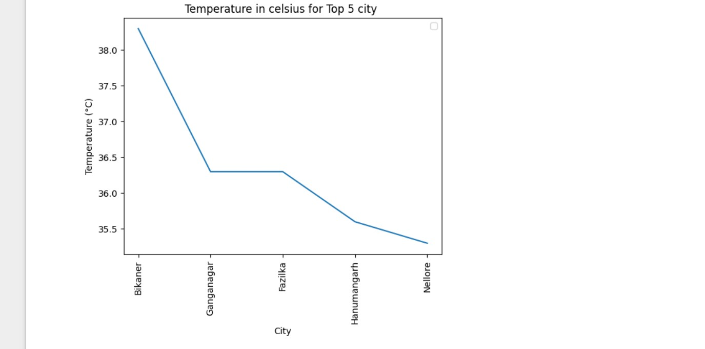
Solution
India, with its diverse geographical and climatic conditions, experiences a wide range of weather phenomena, including monsoons, cyclones, heatwaves, and cold waves. Access to accurate and timely weather data is crucial for various sectors such as agriculture, disaster management, urban planning, and healthcare. While there are existing weather repositories and forecasting systems in India, there are persistent challenges that hinder optimal utilization of weather data.

Slide 8
How its unique
historical weather data, machine learning models, and a platform to host and deploy these models. This could involve collaboration with meteorologists, data scientists, and experts in the field
engagement by allowing users to contribute data or report local weather conditions. This can enhance the accuracy and timeliness of the information.
Design the solution to be scalable, considering the potential increase in data volume over time. Cloud platforms like AWS, Azure, or Google Cloud can provide scalable infrastructure.
Store historical weather data to allow users to analyze trends and patterns over time. Historical data is valuable for research, planning, and decision-making.

Slide 9
Modelling(Analysis Model)And Visualisation
Process
Data Preprocessing
Model Building
Training and Evaluation
Visualization
Charts and Graphs Bar charts, line graphs, scatter plots, etc., for displaying relationships and trends.
Dashboards Integrated views of multiple visualizations to provide a comprehensive overview.
Infographics Visual representations that simplify complex information.

Slide 10
Demo – Analysis Dashboard
https://github.com/aashikaraj/module-5

Slide 11
Government Agencies Agricultural Sector Aviation Industry Shipping and Maritime Industry Media tOURIST General Public Research Institutions Emergency Services Energy Sector
WHO ARE THE END USERS

Slide 12
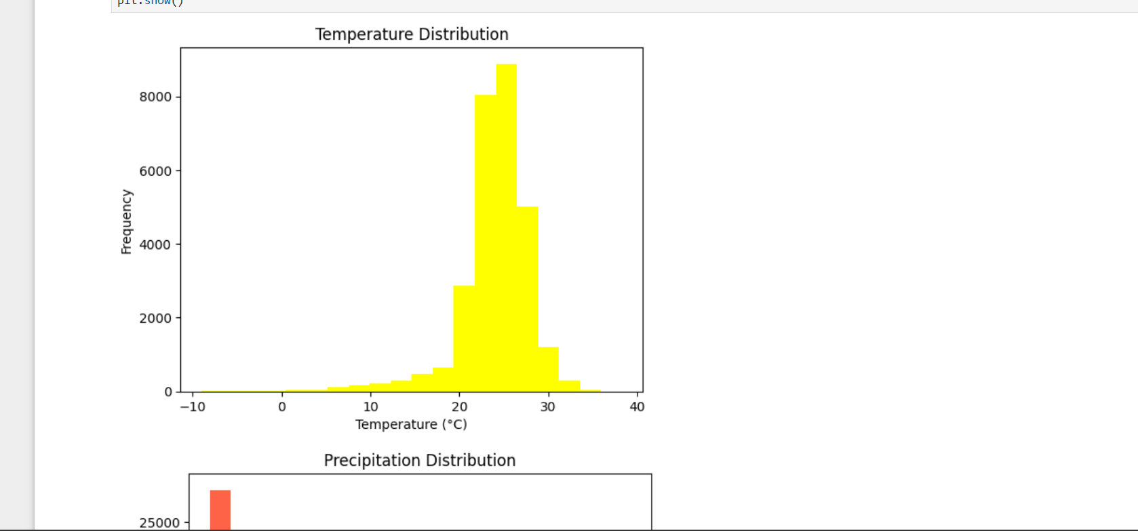
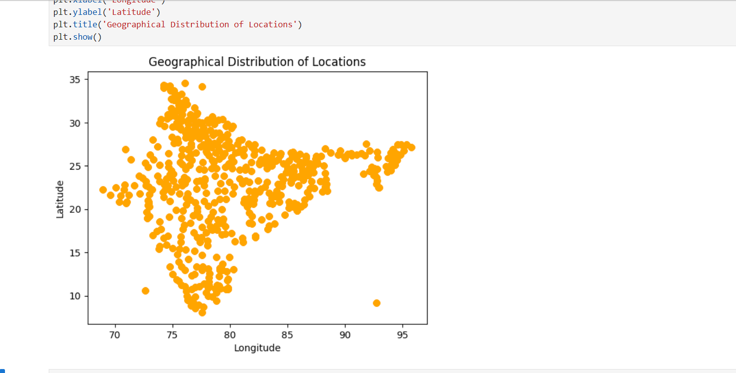
Result(Prediction Model)

Slide 13


